Slide 1

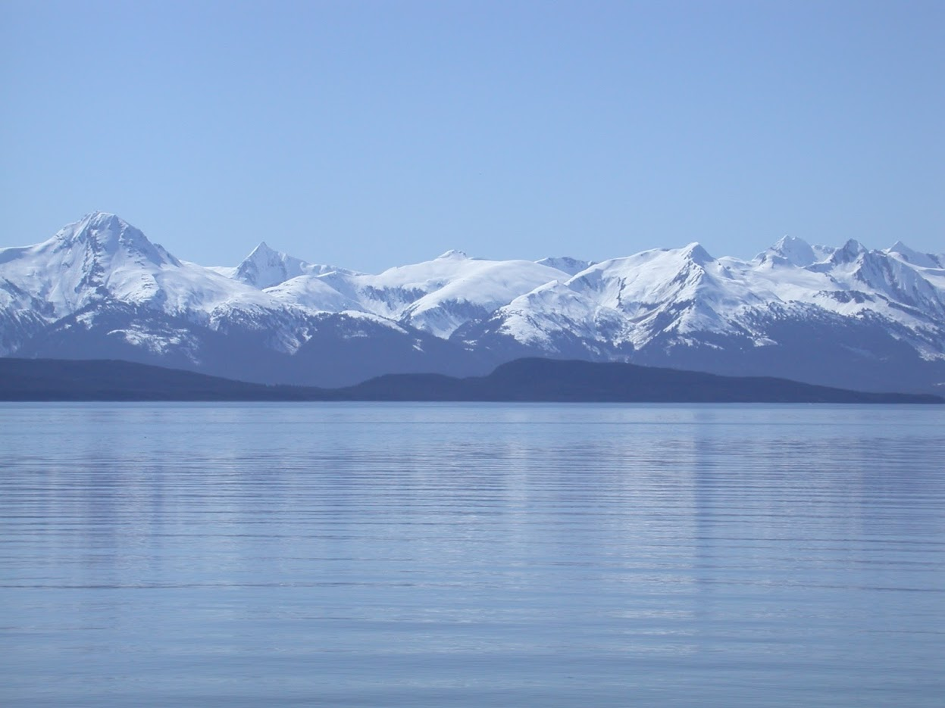


Dusky Rockfish
GOA Groundfish Plan Team
Ben Williams, Pete Hulson, Chris Lunsford, and Bridget Ferriss
November, 2022

Slide 2
Teams or SSC Comments
The Team recommends all GOA authors evaluate any bottom trawl survey information used in their assessment prior to 1990 including the 1984 and 1987 surveys and conduct sensitivity analyses to evaluate their usefulness to the assessment” (PT, November 2021)
The 1980s survey data has been removed – iterative model evaluations were completed.
“...Finally, the SSC requests that design-based estimates of survey biomass be included in comparisons with VAST model estimates.
The SSC requests the assessment author justify the use of the new parameterization of VAST specifically as it relates to dusky rockfish. Past SSC discussions regarding the general implementation of VAST in assessments precluded a highly prescriptive approach and specifically recommended allowing for some species-specific adaptations of the VAST framework “(October 2020)
A suite of VAST parameterizations, associated diagnostics and design-based survey estimates have been explored and are provided as an appendix. The author’s recommended model uses a lognormal error model instead of the GAP default model.
“The SSC registers concern with the large positive retrospective pattern in the recommended model and suggests that further investigation of this be a very high priority.” (January 2020)
Issues with the retrospective pattern are addressed with the author’s recommended model, changing the Mohn’s rho value from 0.51 to -0.123.
Notes:
PT/SSC comments being addressed IN THIS PRESENTATION ONLY

Slide 3
Data Summary
Source | Data | Years
NMFS Groundfish survey | Survey biomass | 1990-1999 (triennial), 2001-2019 (biennial), 2021
 | Age composition | 1990-1999 (triennial), 2003-2019 (biennial), 2021
U.S. trawl fishery | Catch | 1961-2020, 2021-2022
 | Age composition | 1998-2002, 2004-2006, 2008-2018 (biennial), 2020
 | Length composition | 1991-1997, 2003, 2007-2019 (biennial), 2021

Slide 4
Model Variants
Model | Description
base | 2020 model (m15.5a) and results (includes 1980s survey data)
m15.5a | base model w/data updated through 2022, using GAP default VAST
m22 | m15.5a using GAP default VAST (survey data 1990+)
m22.1 | m22 w/increased length plus group
m22.2 | m22 w/increased age plus group
m22.3 | m22 w/increased age & length plus groups
m22a | m22 using lognormal error VAST (survey data 1990+)
m22.1a | M22.1 w/lognormal VAST
m22.2a | M22.2 w/lognormal VAST
m22.3a | M22.3 w/lognormal VAST
m22b | m22 using design-based survey abundance (1990+)
m22.1b | M22.1 w/db survey
m22.2b | M22.2 w/db survey
m22.3b | M22.3 w/db survey

Slide 5
Model Variants
base
M15.5a (2022)
M22
1990+ survey
M22a
lognormal
M22b
design-based
M22.1
Length+
M22.1a
M22.1b
M22.2
Age+
M22.2a
M22.2b
M22.3
Age/length+
M22.3a
M22.3b

Slide 6
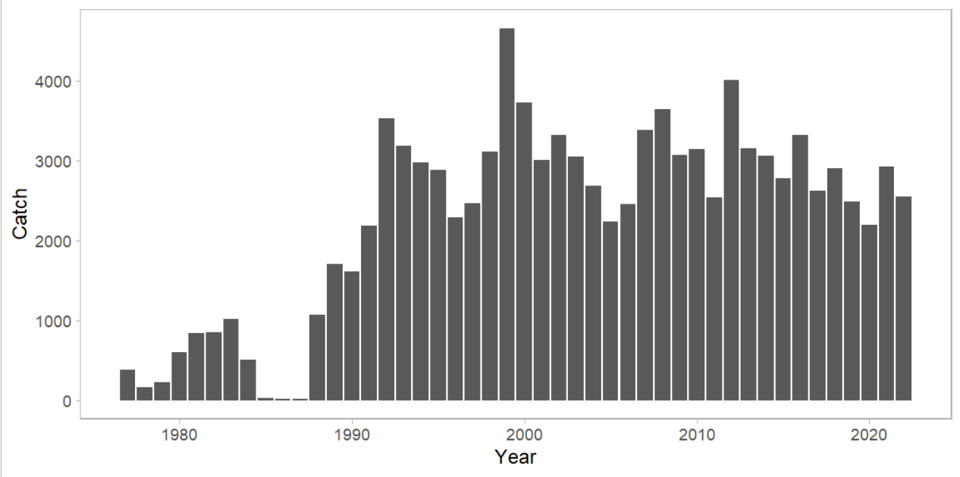
Inputs - Catch
Notes:
Time series with highlights of trends and any issues (e.g., overages, data issues, discards), provide regional breakdown time series or spatial distribution maps only if relevant to data interpretation or model evaluation

Slide 7
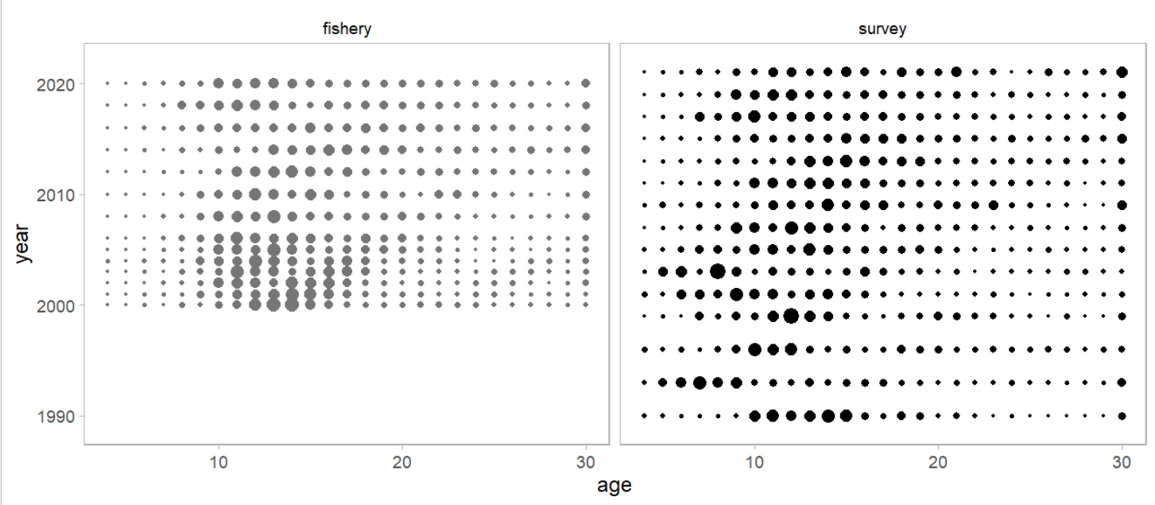
Inputs -Age Composition

Slide 8
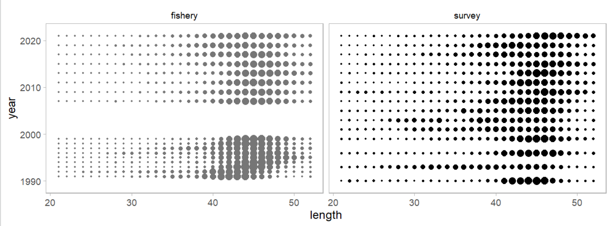
Inputs - Size Composition

Slide 9
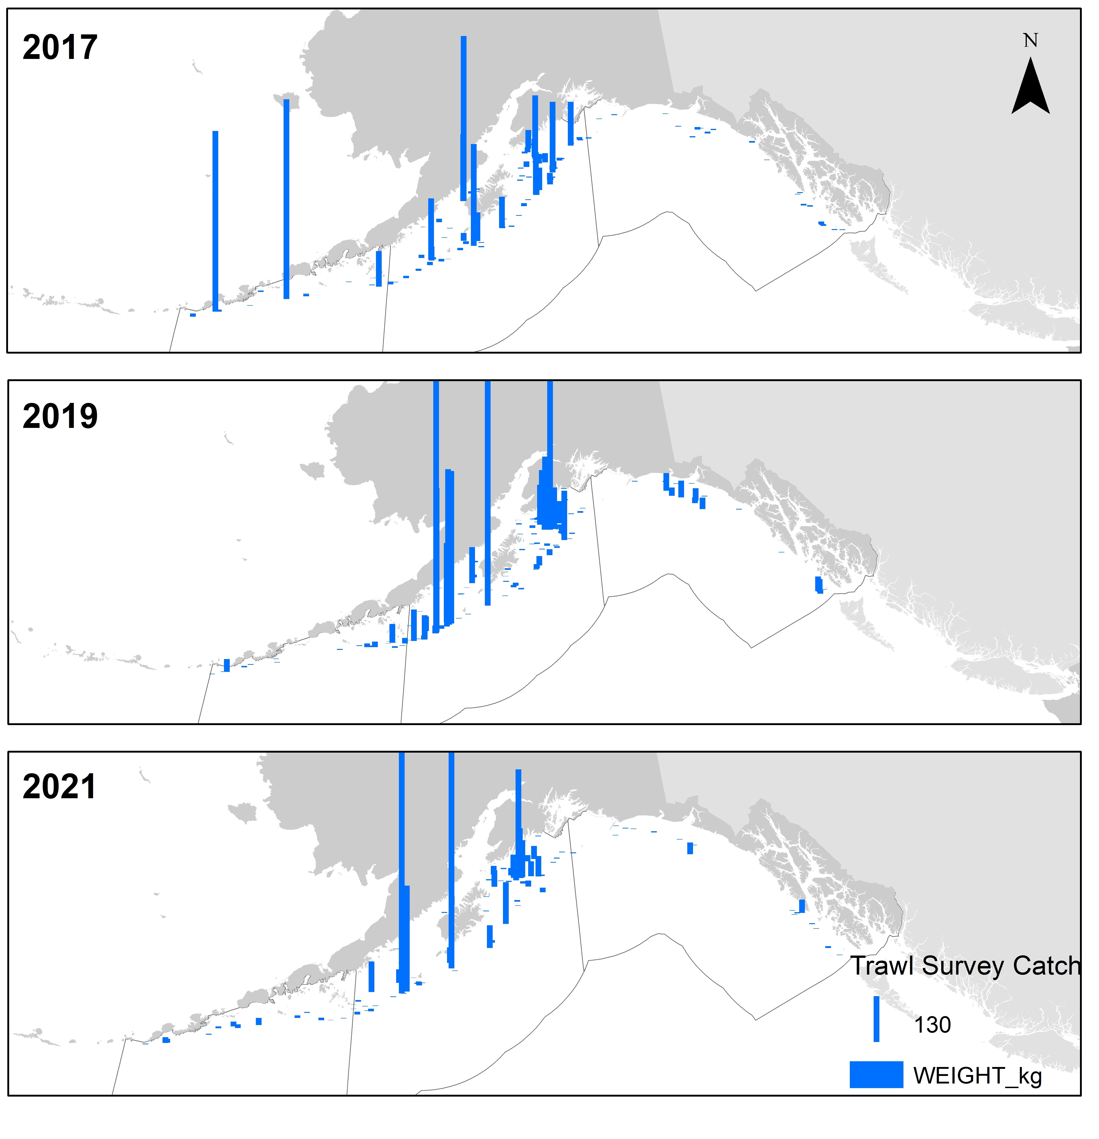
Inputs - GOA Bottom Trawl Survey

Slide 10
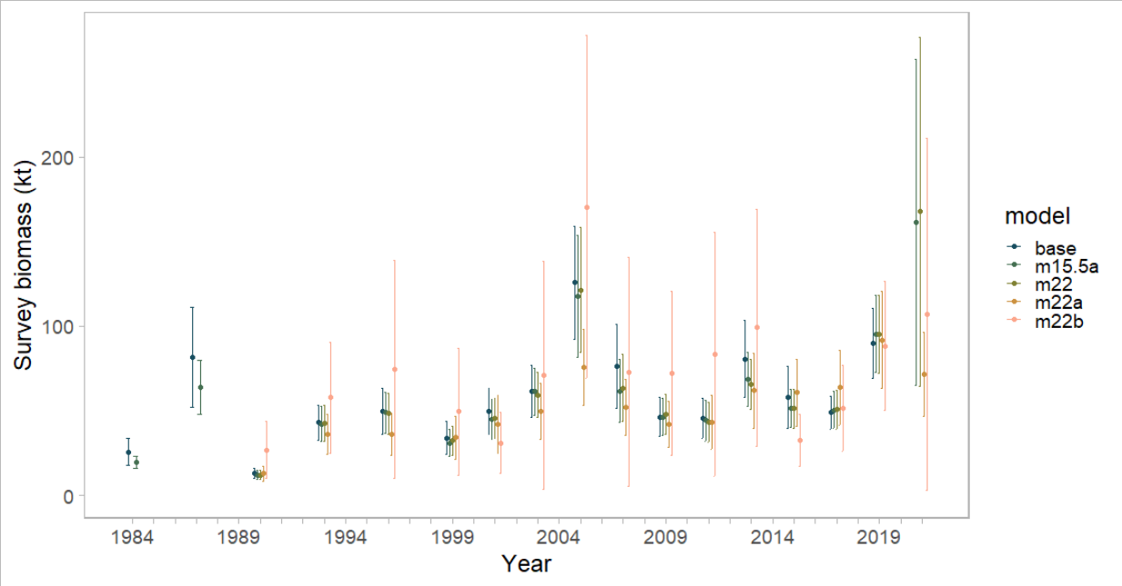
Inputs - GOA Bottom Trawl Survey
Notes:
5 trawl survey biomass estimates: base (GAP default) – updated base w/2021 data, m22 – removes 1980s data, m22a lognormal error, m22b design-based

Slide 11
Model Summary
Model | Description
base | 2020 model (m15.5a) and results (includes 1980s survey data)
m15.5a | base model w/data updated through 2022, using GAP default VAST
m22 | m15.5a using GAP default VAST (survey data 1990+)
m22.1 | m22 w/increased length plus group
m22.2 | m22 w/increased age plus group
m22.3 | m22 w/increased age & length plus groups
m22a | m22 using lognormal error VAST (survey data 1990+)
m22.1a | M22.1 w/lognormal VAST
m22.2a | M22.2 w/lognormal VAST
m22.3a | M22.3 w/lognormal VAST
m22b | m22 using design-based survey abundance (1990+)
m22.1b | M22.1 w/db survey
m22.2b | M22.2 w/db survey
m22.3b | M22.3 w/db survey
No Mdel Changes
Same model as 2018, see Spies et al. 2018 for more details
Split-sex, age structured model…

Slide 12
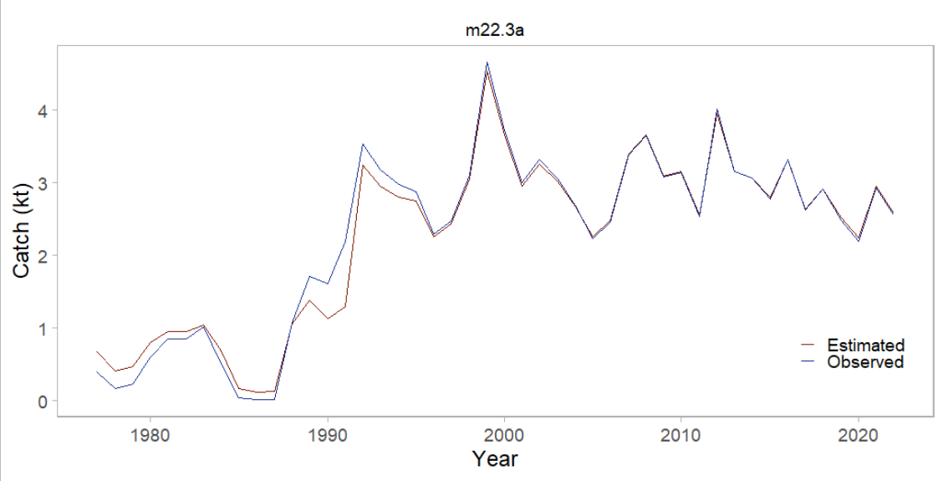
Model Fit - Catch
Notes:
Should include graphs of model fit to time series and compositions shown in the Data Summary section, preferably in the same order (e.g., Model Fit - Catch, then Model Fit - Fishery Age Composition,...), may include convergence or goodness of fit statistics, if evaluating multiple models show fit of all models evaluated for time series and compositions, highlight any lack of fit, may provide likelihood comparison table

Slide 13
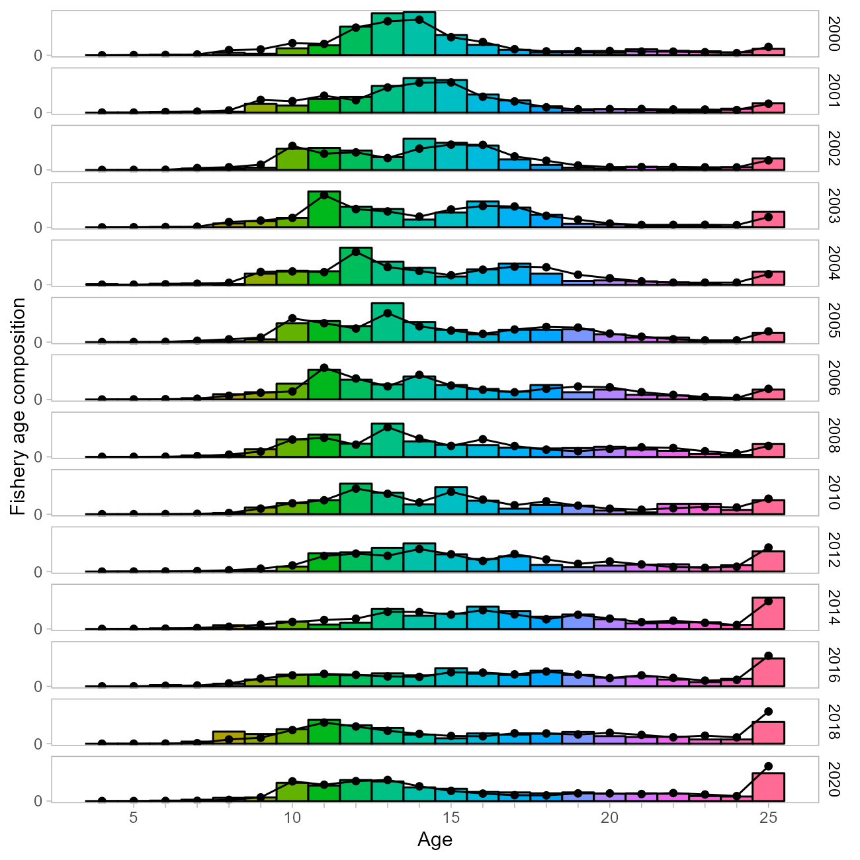
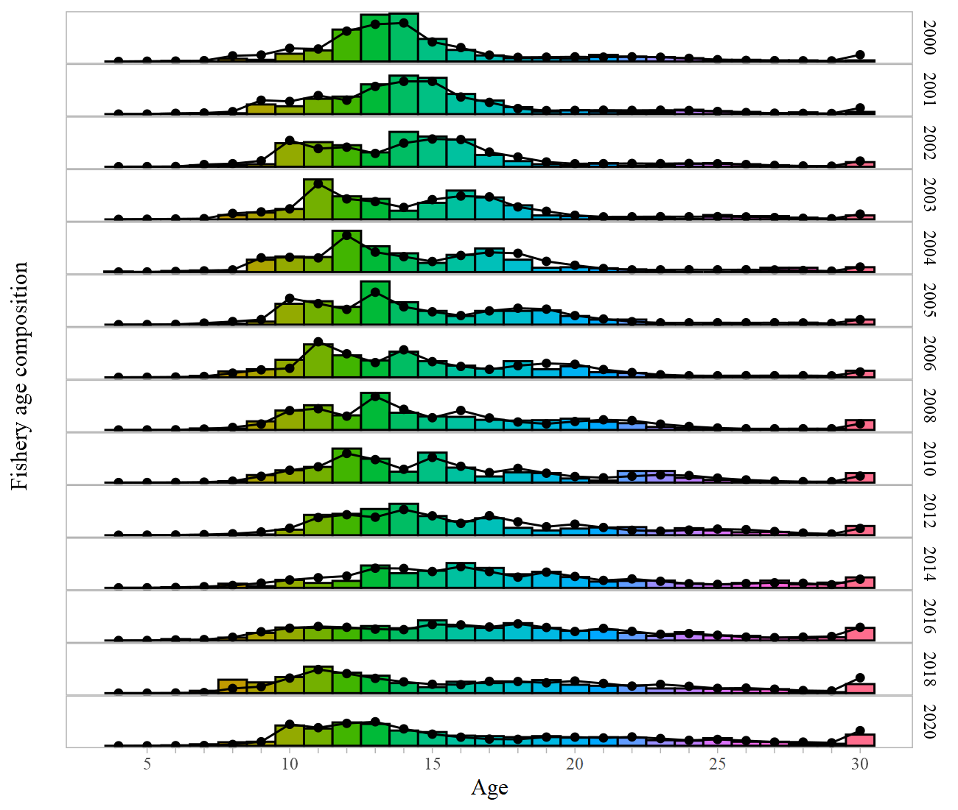
Model Fit - Fishery Size Composition
Notes:
Should include graphs of model fit to time series and compositions shown in the Data Summary section, preferably in the same order (e.g., Model Fit - Catch, then Model Fit - Fishery Age Composition,...), may include convergence or goodness of fit statistics, if evaluating multiple models show fit of all models evaluated for time series and compositions, highlight any lack of fit, may provide likelihood comparison table

Slide 14
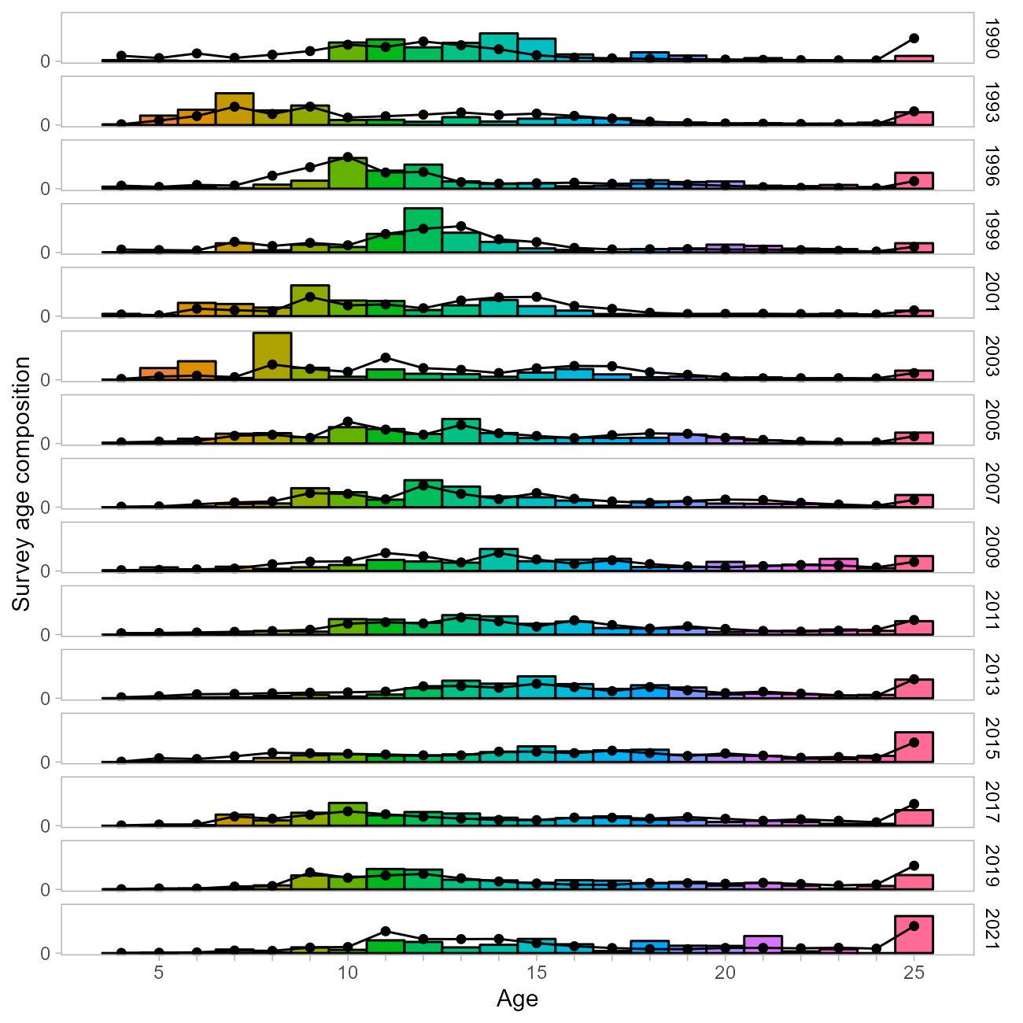
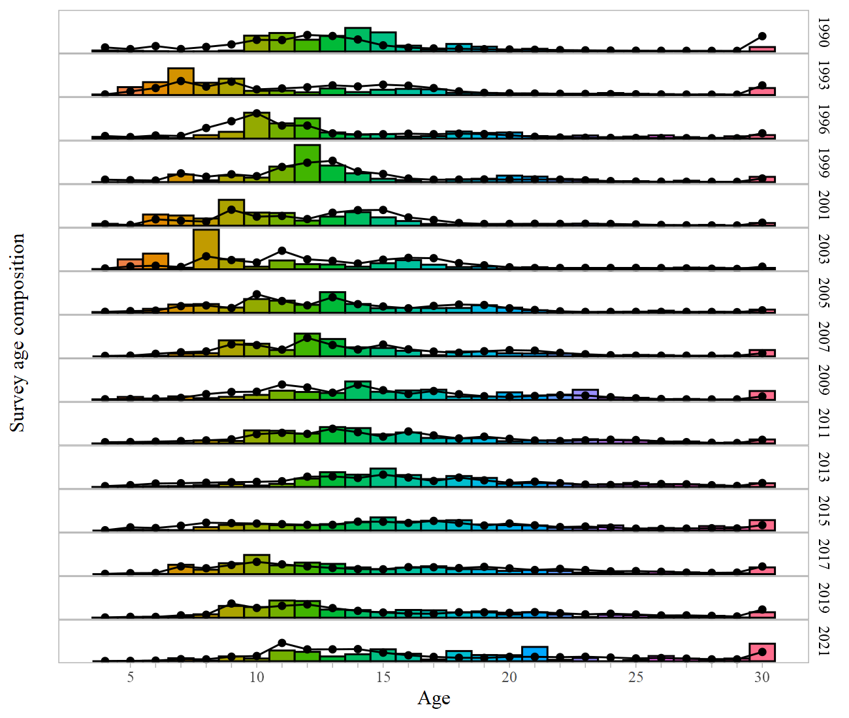
Model Fit - Survey Age Composition
Notes:
Should include graphs of model fit to time series and compositions shown in the Data Summary section, preferably in the same order (e.g., Model Fit - Catch, then Model Fit - Fishery Age Composition,...), may include convergence or goodness of fit statistics, if evaluating multiple models show fit of all models evaluated for time series and compositions, highlight any lack of fit, may provide likelihood comparison table

Slide 15
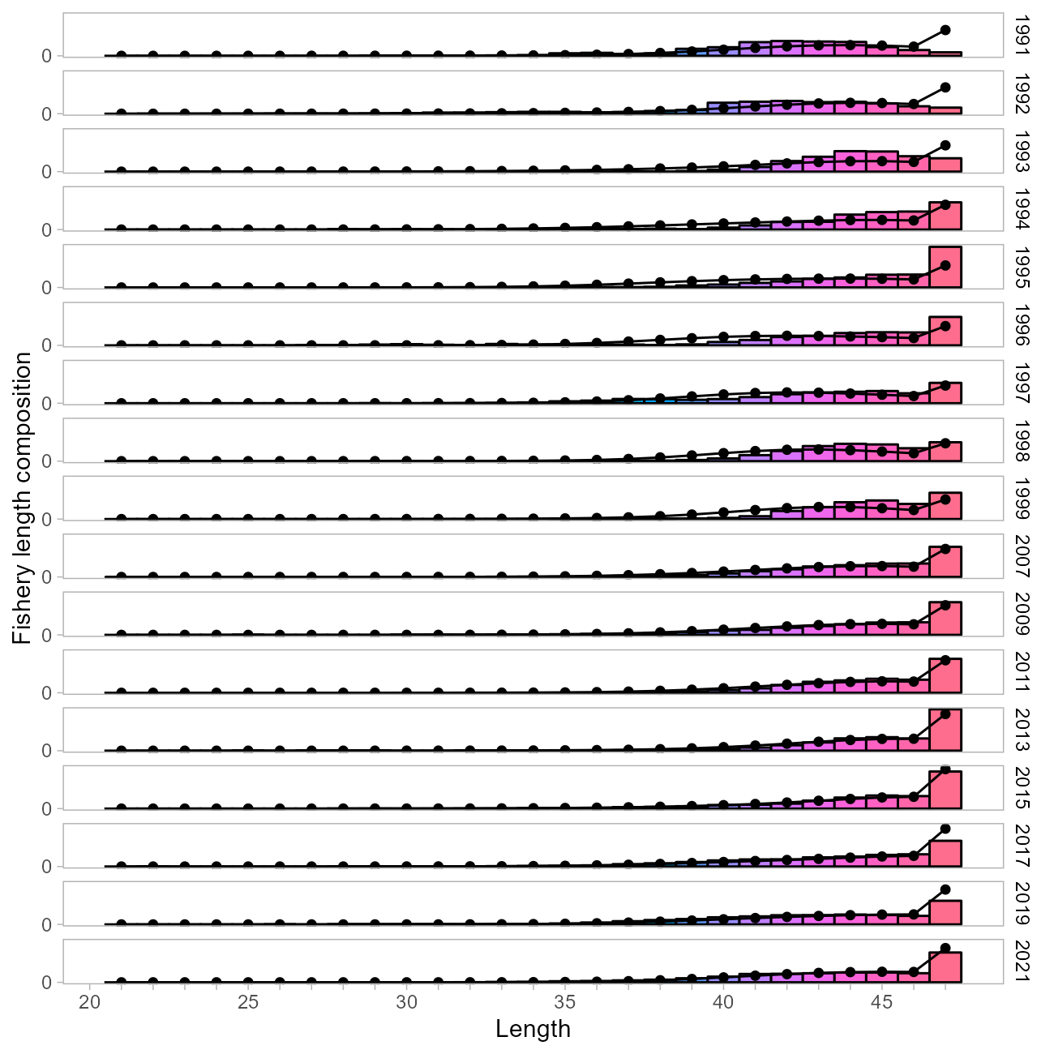
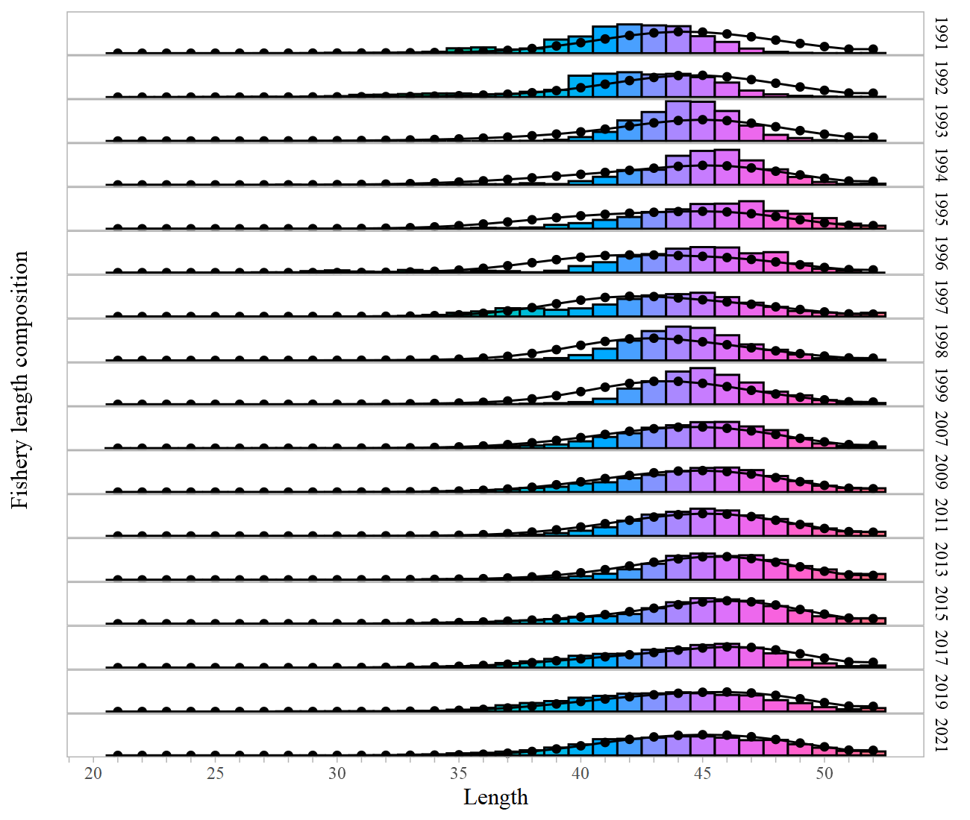
Model Fit - Fishery Length Composition
Notes:
Should include graphs of model fit to time series and compositions shown in the Data Summary section, preferably in the same order (e.g., Model Fit - Catch, then Model Fit - Fishery Age Composition,...), may include convergence or goodness of fit statistics, if evaluating multiple models show fit of all models evaluated for time series and compositions, highlight any lack of fit, may provide likelihood comparison table

Slide 16
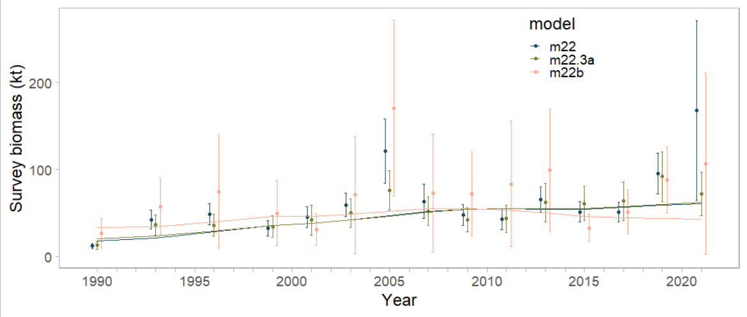
Model Fit - Survey Biomass
Notes:
Should include graphs of model fit to time series and compositions shown in the Data Summary section, preferably in the same order (e.g., Model Fit - Catch, then Model Fit - Fishery Age Composition,...), may include convergence or goodness of fit statistics, if evaluating multiple models show fit of all models evaluated for time series and compositions, highlight any lack of fit, may provide likelihood comparison table

Slide 17
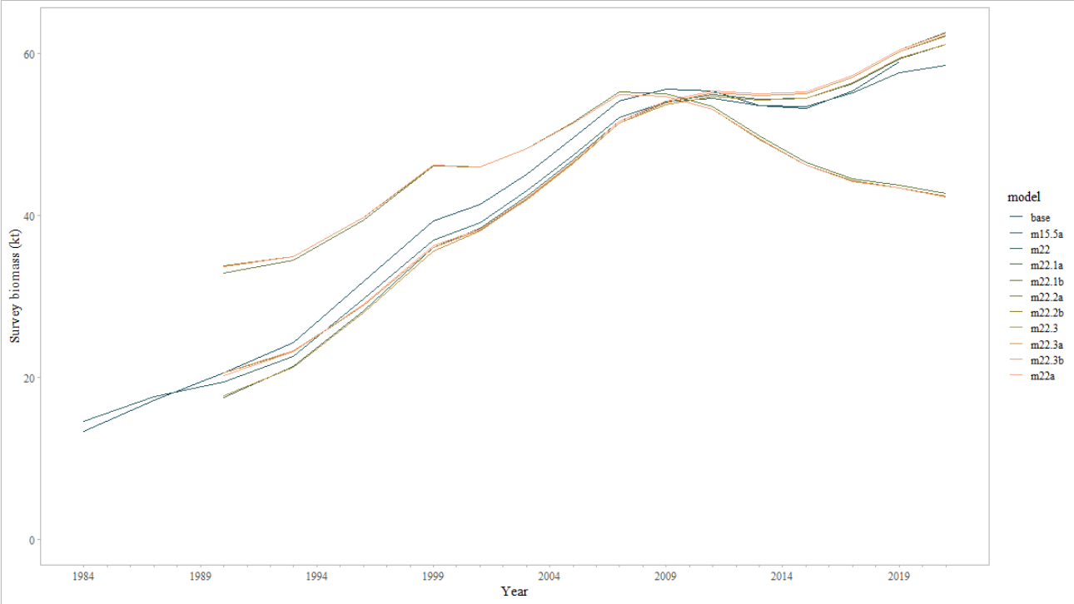
Model Fit - Survey Biomass
Notes:
Survey fits are generally similar (exception ben

Slide 18
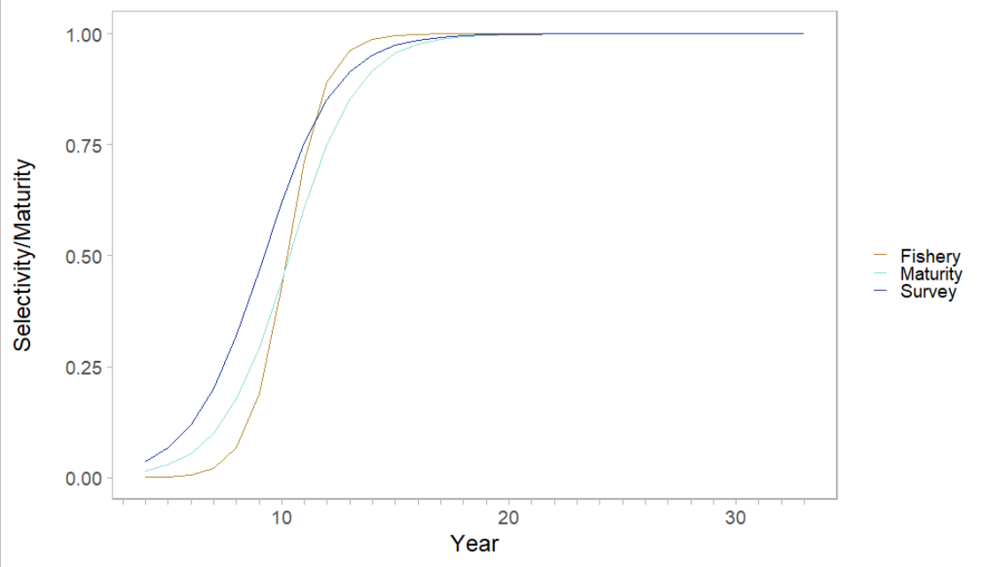
Selectivity
Notes:
Selectivity and maturity are essentially the same for all model variants

Slide 19
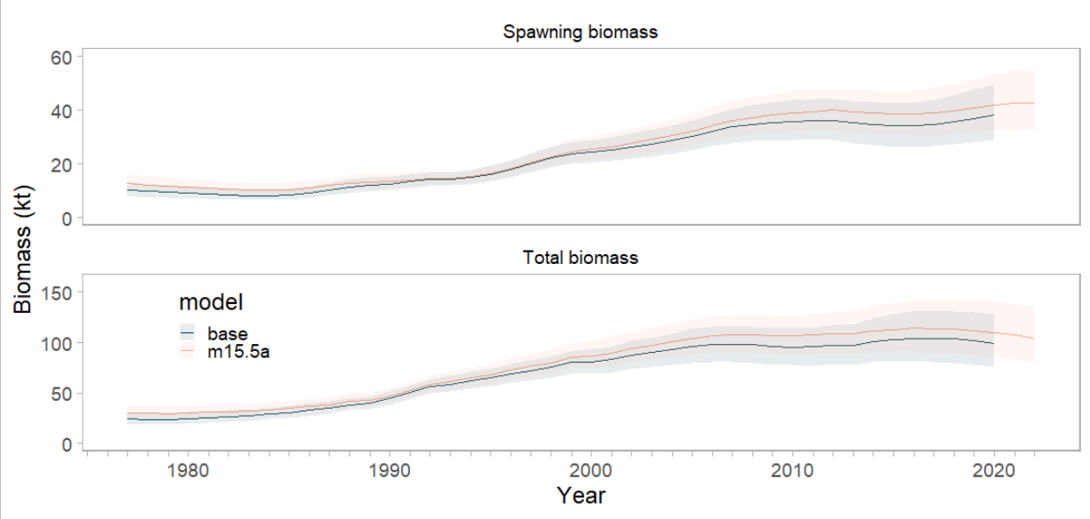
Time Series - Spawning Stock Biomass
Notes:
Graph to include at minimum estimates of Spawning Stock Biomass, Total Biomass, Recruitment, Fishing Mortality (e.g., Time Series - Spawning Stock Biomass), if evaluating multiple models include time series for all models evaluated on same graph, highlight author recommended model

Slide 20
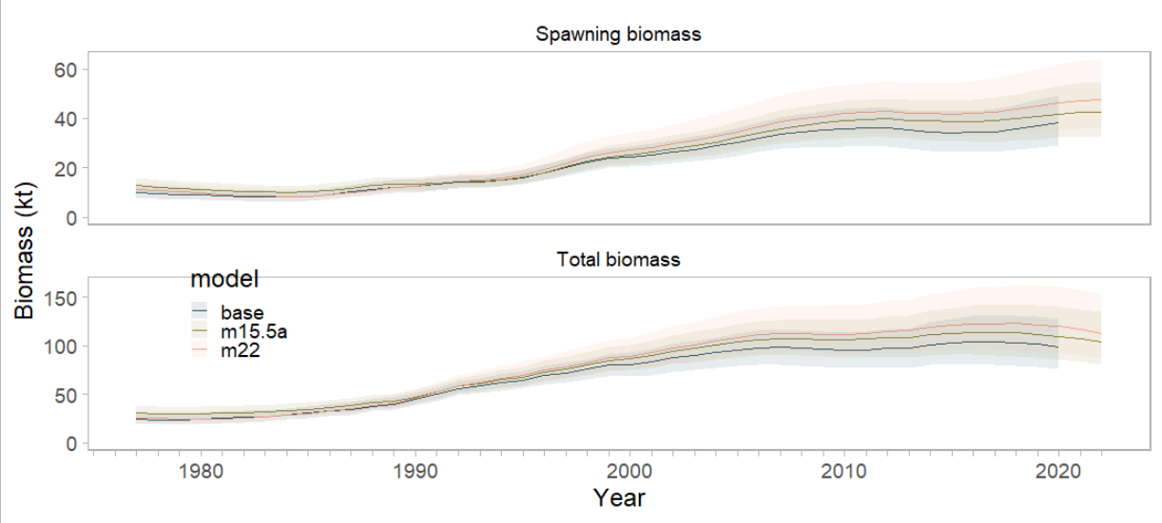
Time Series - Spawning Stock Biomass
Notes:
Graph to include at minimum estimates of Spawning Stock Biomass, Total Biomass, Recruitment, Fishing Mortality (e.g., Time Series - Spawning Stock Biomass), if evaluating multiple models include time series for all models evaluated on same graph, highlight author recommended model

Slide 21
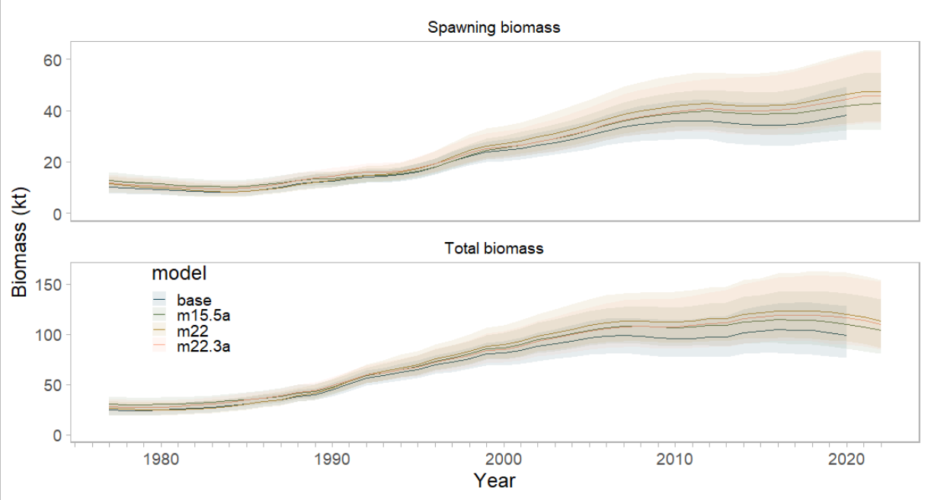
Time Series - Spawning Stock Biomass
Notes:
Graph to include at minimum estimates of Spawning Stock Biomass, Total Biomass, Recruitment, Fishing Mortality (e.g., Time Series - Spawning Stock Biomass), if evaluating multiple models include time series for all models evaluated on same graph, highlight author recommended model

Slide 22
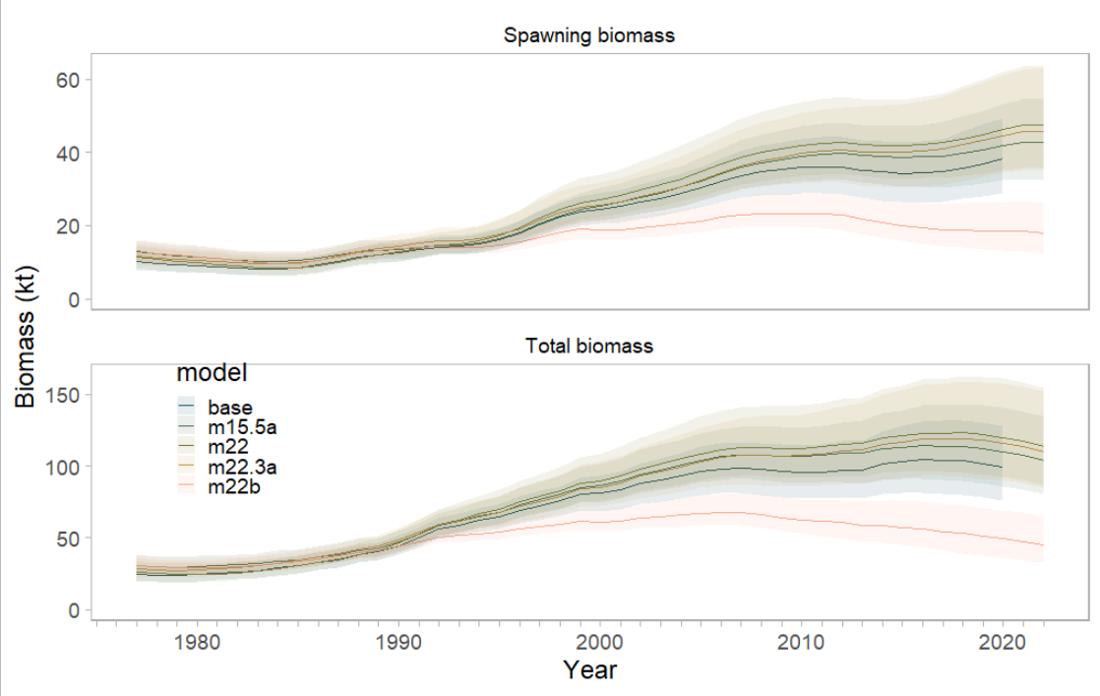
Time Series - Spawning Stock Biomass
Notes:
Graph to include at minimum estimates of Spawning Stock Biomass, Total Biomass, Recruitment, Fishing Mortality (e.g., Time Series - Spawning Stock Biomass), if evaluating multiple models include time series for all models evaluated on same graph, highlight author recommended model

Slide 23
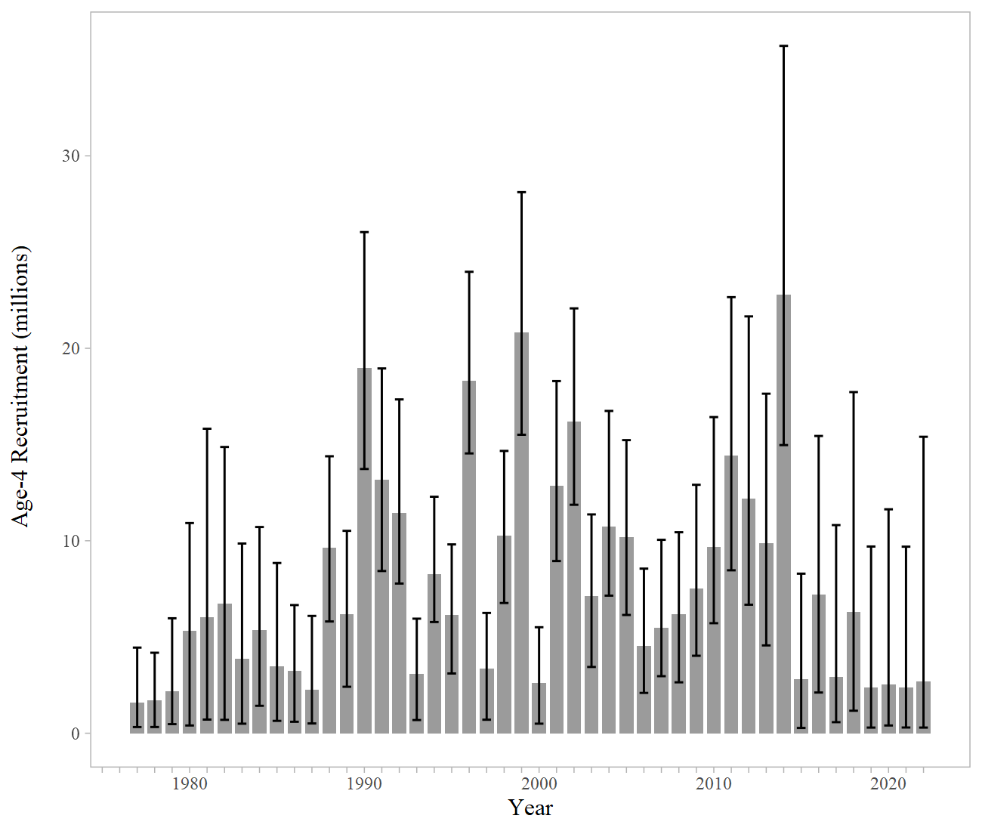
Time Series - Recruitment
Notes:
Graph to include at minimum estimates of Spawning Stock Biomass, Total Biomass, Recruitment, Fishing Mortality (e.g., Time Series - Spawning Stock Biomass), if evaluating multiple models include time series for all models evaluated on same graph, highlight author recommended model

Slide 24
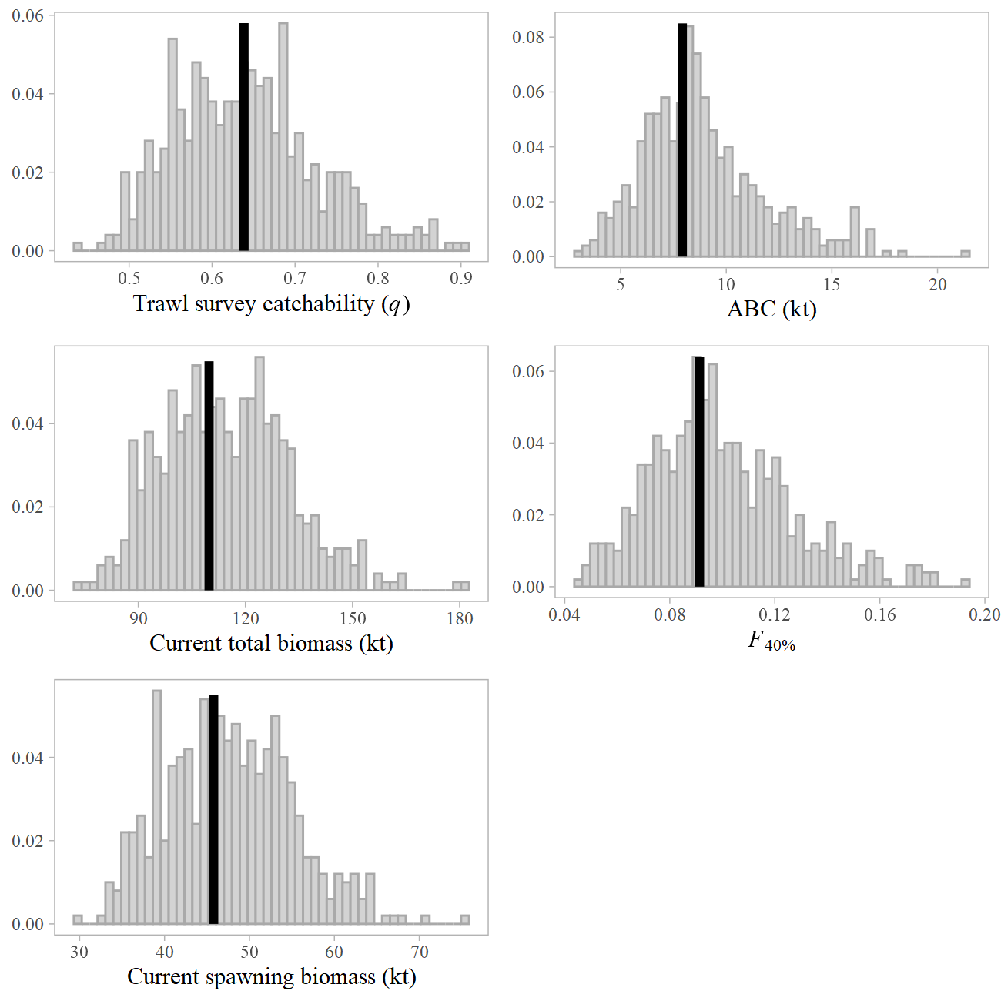
Parameters

Slide 25
Likelihoods | base | m15.5a | m22 | m22.1 | m22.2 | m22.3 | m22a | m22.1a | m22.2a | m22.3a
Catch | 26.96 | 29.70 | 25.06 | 24.94 | 25.24 | 25.16 | 25.57 | 25.40 | 25.85 | 25.72
Survey biomass | 98.95 | 118.58 | 74.21 | 74.19 | 75.70 | 75.70 | 29.23 | 29.21 | 30.05 | 30.03
Fishery ages | 32.84 | 36.73 | 36.60 | 36.41 | 43.76 | 43.52 | 35.06 | 34.90 | 41.74 | 41.52
Survey ages | 124.75 | 145.09 | 130.01 | 130.40 | 140.01 | 140.32 | 127.16 | 127.49 | 137.85 | 138.14
Fishery lengths | 49.29 | 57.92 | 53.82 | 58.57 | 55.15 | 60.12 | 53.86 | 58.66 | 55.04 | 60.03
Data | 332.80 | 388.03 | 319.70 | 324.51 | 339.86 | 344.82 | 270.89 | 275.66 | 290.54 | 295.43
Penalties/Priors
Recruitment devs | 38.83 | 33.91 | 41.34 | 42.09 | 40.88 | 41.58 | 36.30 | 37.13 | 35.43 | 36.21
F regularity | 31.62 | 35.51 | 32.60 | 32.34 | 32.91 | 32.71 | 34.16 | 33.87 | 34.21 | 33.98
σ_{r} prior | 0.25 | 0.40 | 0.22 | 0.20 | 0.29 | 0.28 | 0.34 | 0.31 | 0.43 | 0.41
q prior | 0.32 | 0.60 | 0.64 | 0.59 | 0.83 | 0.77 | 0.45 | 0.41 | 0.54 | 0.50
Objective function | 468.81 | 523.65 | 459.28 | 464.53 | 479.47 | 484.87 | 406.80 | 412.08 | 425.72 | 431.13
Parameter estimates
# parameters | 124 | 126 | 128 | 128 | 133 | 133 | 128 | 128 | 133 | 133
q | 0.70 | 0.61 | 0.60 | 0.62 | 0.56 | 0.57 | 0.65 | 0.67 | 0.63 | 0.64
σ_{r} | 1.10 | 1.01 | 1.12 | 1.13 | 1.07 | 1.08 | 1.04 | 1.05 | 0.99 | 1.00
Mean recruitment | 2.22 | 0.99 | 0.90 | 0.87 | 0.97 | 0.95 | 0.96 | 0.94 | 1.02 | 0.99
F_{40%} | 0.93 | 0.09 | 0.09 | 0.09 | 0.09 | 0.09 | 0.09 | 0.09 | 0.09 | 0.09
Projected total biomass | 97,702 | 101,171 | 110,493 | 108,291 | 117,133 | 115,044 | 105,736 | 103,929 | 108,833 | 107,160
Projected spawning biomass | 38,362 | 41,453 | 46,083 | 45,142 | 48,951 | 48,056 | 43,847 | 43,083 | 45,164 | 44,495
B_{100%} | 60,855 | 63,038 | 67,517 | 66,669 | 70,174 | 69,358 | 64,914 | 64,249 | 66,181 | 65,565
B_{40%} | 24,342 | 25,215 | 27,007 | 26,667 | 28,070 | 27,743 | 25,966 | 25,699 | 26,473 | 26,226
ABC | 7,101 | 7,279 | 8,187 | 8,030 | 8,660 | 8,511 | 7,829 | 7,702 | 8,037 | 7,917
Notes:
Comparison table of main estimated parameters with uncertainty estimates, if evaluating multiple models provide parameter estimates for all models evaluated, highlight author recommended model

Slide 26
Parameters
Likelihoods | m22b | m22.1b | m22.2b | m22.3b
Catch | 33.04 | 32.76 | 33.99 | 33.76
Survey biomass | 20.99 | 21.00 | 21.10 | 21.11
Fishery ages | 34.75 | 34.59 | 41.02 | 40.79
Survey ages | 125.73 | 125.94 | 137.18 | 137.36
Fishery lengths | 53.86 | 58.68 | 54.91 | 59.92
Data | 268.37 | 272.97 | 288.20 | 292.93
Penalties/Priors
Recruitment devs | 15.31 | 16.50 | 12.04 | 13.14
F regularity | 6.36 | 35.94 | 36.54 | 36.19
σ_{r} prior | 1.09 | 1.03 | 1.29 | 1.24
q prior | 0.01 | 0.02 | 0.01 | 0.01
Objective function | 386.15 | 391.45 | 403.08 | 408.51
Parameter estimates
# parameters | 128 | 128 | 133 | 133
q | 1.08 | 1.09 | 1.06 | 1.07
σ_{r} | 0.78 | 0.79 | 0.73 | 0.74
Mean recruitment | 0.89 | 0.87 | 0.93 | 0.91
F_{40%} | 0.09 | 0.09 | 0.09 | 0.09
Projected total biomass | 43,553 | 42,883 | 43,576 | 42,990
Projected spawning biomass | 16,839 | 16,583 | 16,780 | 16,556
B_{100%} | 42,320 | 42,140 | 42,316 | 42,153
B_{40%} | 16,928 | 16,856 | 16,926 | 16,861
ABC | 2,984 | 2,909 | 2,955 | 2,890
Design-based survey inputs
Notes:
Comparison table of main estimated parameters with uncertainty estimates, if evaluating multiple models provide parameter estimates for all models evaluated, highlight author recommended model

Slide 27
Retrospective – Base model (2020)
Mohn’s rho 0.51

Slide 28
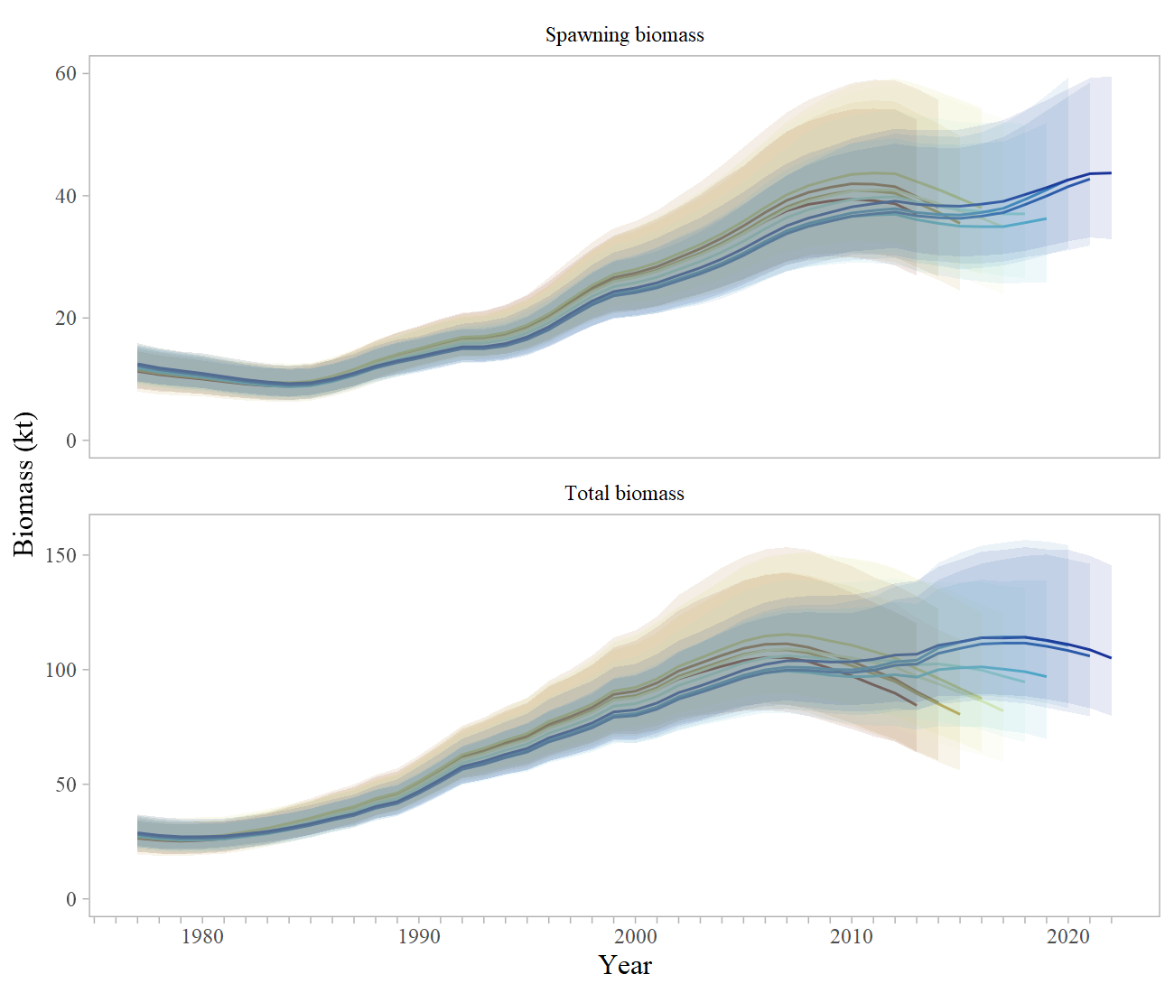
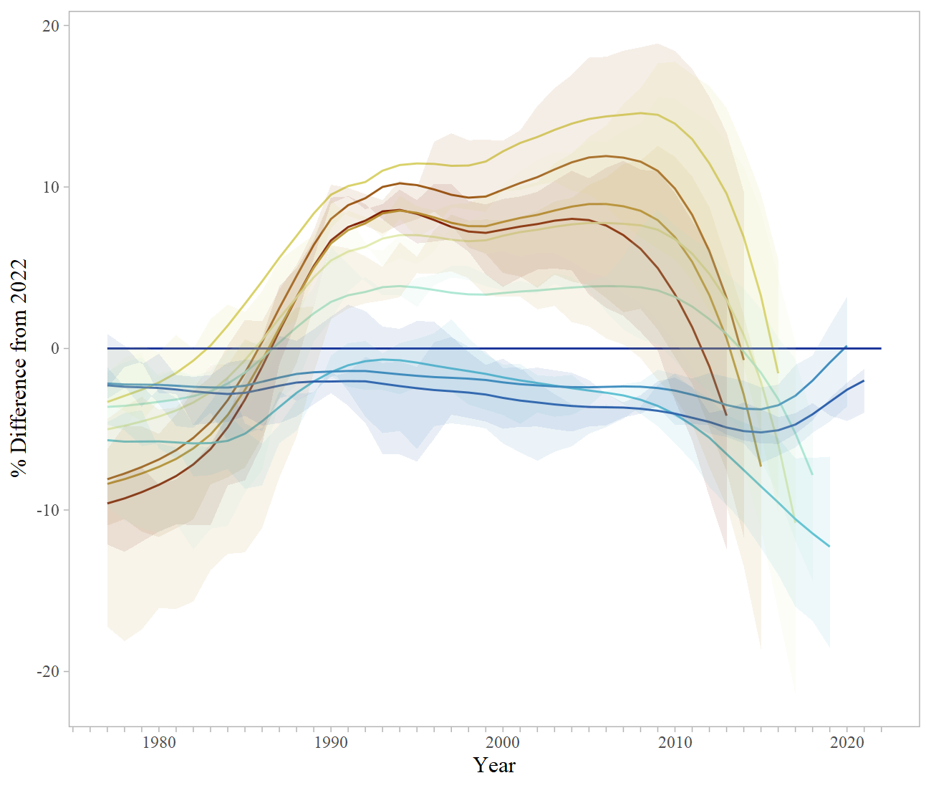
Retrospective – m22.3a
Mohn’s rho -0.123
Base = 0.51
Notes:
Graph of 10 year peel with Mohns rho estimate, if evaluating multiple models include retrospective graph and Mohns rho estimate for base and author recommended model

Slide 29
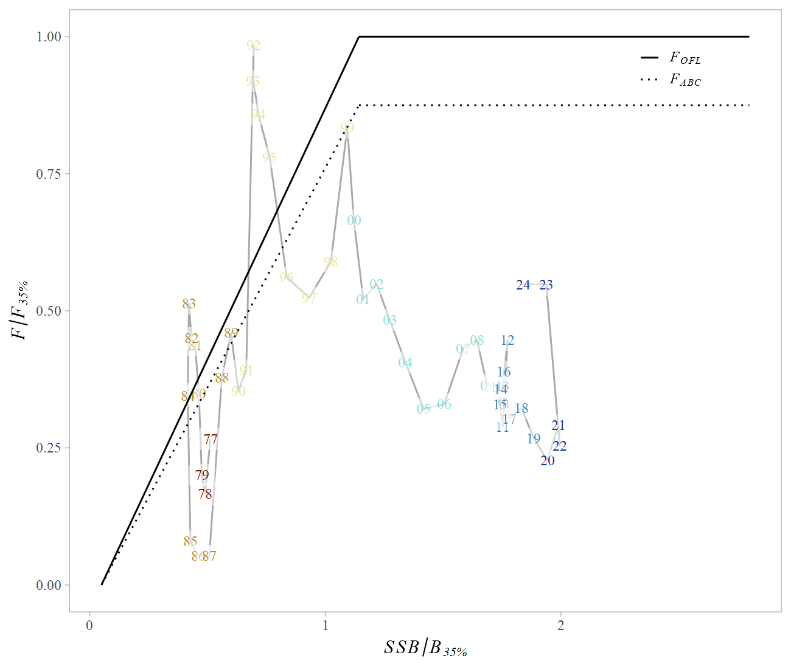
Phase Plane
Notes:
Plot of fishing mortality rate relative to F35% and female spawning biomass relative for B 35% for status

Slide 30
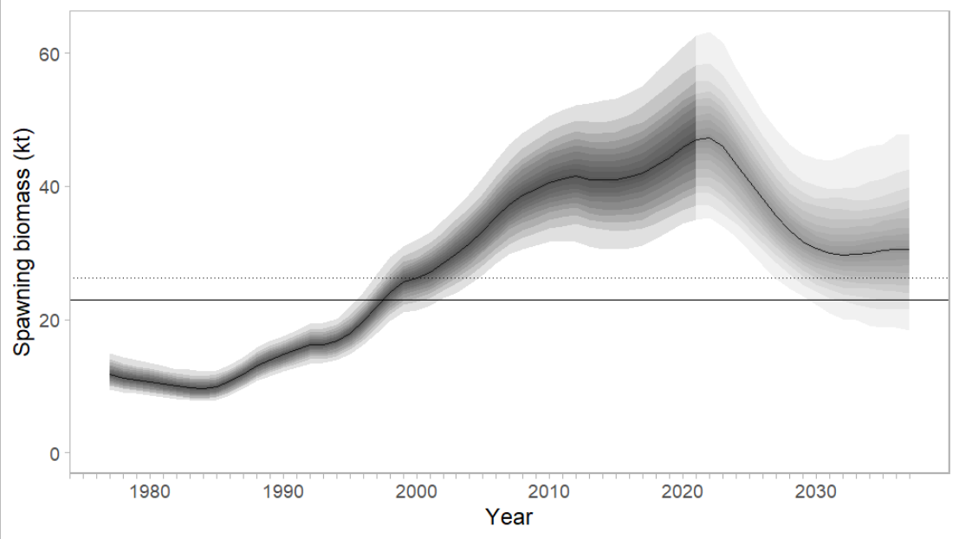
Projection
Notes:
Model graph of Spawning Stock Biomass with B40% and B35% reference lines

Slide 31
Risk Table
Assessment-related considerations | Population dynamics considerations | Environmental/ ecosystem considerations | Fishery Performance
Level 2: Substantially increased concerns | Level 2: Substantially increased concerns | Level 1: No increased concerns | Level 1: No increased concerns
Assessment - sensitivity of the model to the scale of the VAST model biomass estimates, as well as the low uncertainty from VAST
Population dynamics –skip spawning has been observed for this stock, levels unknown
Environmental - environmental mechanisms for changes in survival and productivity of dusky rockfish remain unknown, though indication that structural epifauna habitat may be decreasing
Fishery performance - catches are well below ABC

Slide 32
Harvest Recommendation
 | As estimated or specified last year for: |  | As estimated or recommended this year for:
Quantity/Status | 2022 | 2023 | 2023* | 2024*
M (natural mortality) | 0.07 | 0.07 | 0.07 | 0.07
Tier | 3a | 3a | 3a | 3a
Projected total (age 4+) biomass (t) | 95,682 | 92,310 | 107,160 | 104,627
Projected female spawning biomas (t) | 38,371 | 36,853 | 44,651 | 44,651
B_{100%} | 60,855 | 60,855 | 65,565 | 65,565
B_{40%} | 24,342 | 24,342 | 26,226 | 26,226
B_{35%} | 21,299 | 21,299 | 22,948 | 22,948
F_{OFL} | 0.114 | 0.114 | 0.11 | 0.11
maxF_{ABC} | 0.093 | 0.093 | 0.09 | 0.09
F_{ABC} | 0.093 | 0.093 | 0.09 | 0.09
OFL (t) | 8,614 | 8,146 | 9,638 | 9,154
maxABC (t) | 7,069 | 6,686 | 7,917 | 7,520
ABC (t) | 5,372 | 5,181 | 7,917 | 7,520
 | As determined last year for: |  | As determined this year for:
Status | 2021 | 2022 | 2022 | 2023
Overfishing | No | n/a | No | n/a
Overfished | n/a | No | n/a | No
Approaching overfished | n/a | No | n/a | No
Notes:
Last year was a stairstep ABC – best to look at maxABC

Slide 33
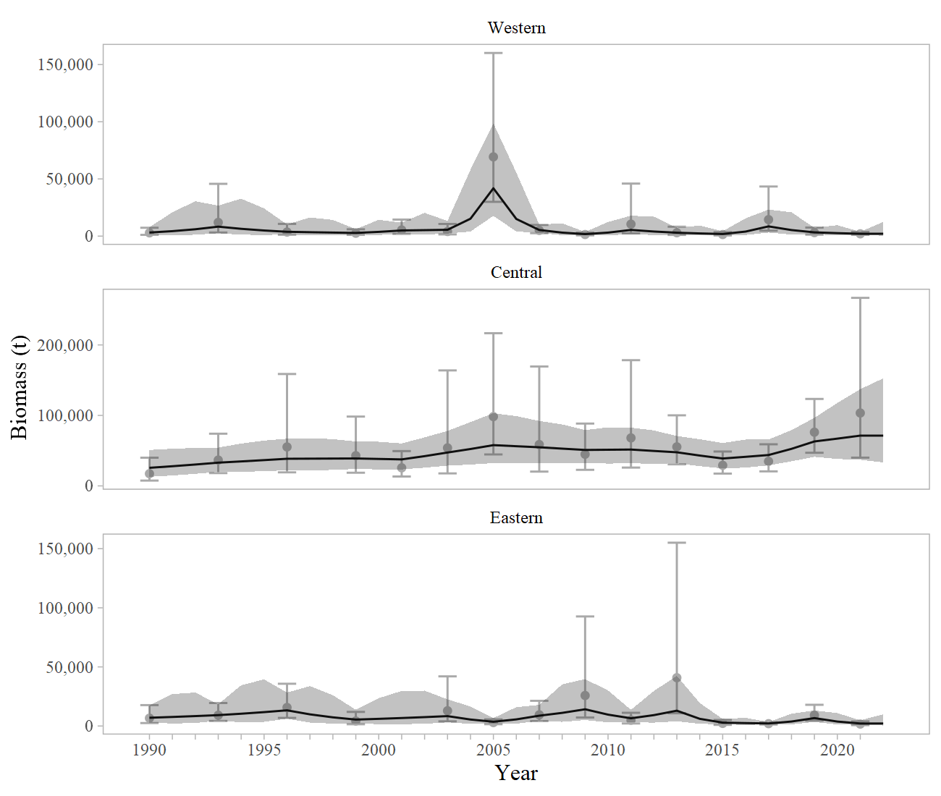
Apportionment
Western 5.0% → 1.9%
Central 84.4% → 96.6%
Eastern 10.6% → 1.5%

Slide 34
Apportionment
 |  | Western | Central | Eastern | Total
Area Apportionment |  | 1.9% | 96.6% | 1.5% | 100%
2023 | ABC (t) | 149 | 7,647 | 121 | 7,917
2023 | OFL (t) |  |  |  | 9,638
2024 | ABC (t) | 141 | 7,264 | 115 | 7,520
2024 | OFL (t) |  |  |  | 9,154
 |  | W. Yakutat | E. Yakutat/Southeast
2023 | ABC (t) | 90 | 31
2024 | ABC (t) | 85 | 30
Notes:
Table where applicable, including random effects model graphs and final apportionment table

Slide 35
Conclusions
Recommendation
Increase age and length plus groups, change to lognormal error in VAST (model 22.3a)
Data Gaps and Future Research Priorities
We have no information on larval, post-larval, or early-stage juvenile dusky rockfish
Habitat requirements are either unknown or anecdotal – research to identify HAPC
Aging is a continual issue (challenging to age well)
Reproductive biology is poorly understood, though skip spawning has been observed – the spatial and temporal extent of skip spawning should be a research priority
Exploration of data weighting, possibly the inclusion of a variance inflation parameter to increase the variance on VAST estimated trawl surveys

Slide 36

QUESTIONS?
CONTACT:
ben.williams@noaa.gov

